Slide 1

PLANT PATROL
AI for Climate Change, Agriculture, and Food Security
P
L
A
N
T
D
I
S
E
A
S
E
D
E
T
E
C
T
I
O
N

Slide 2

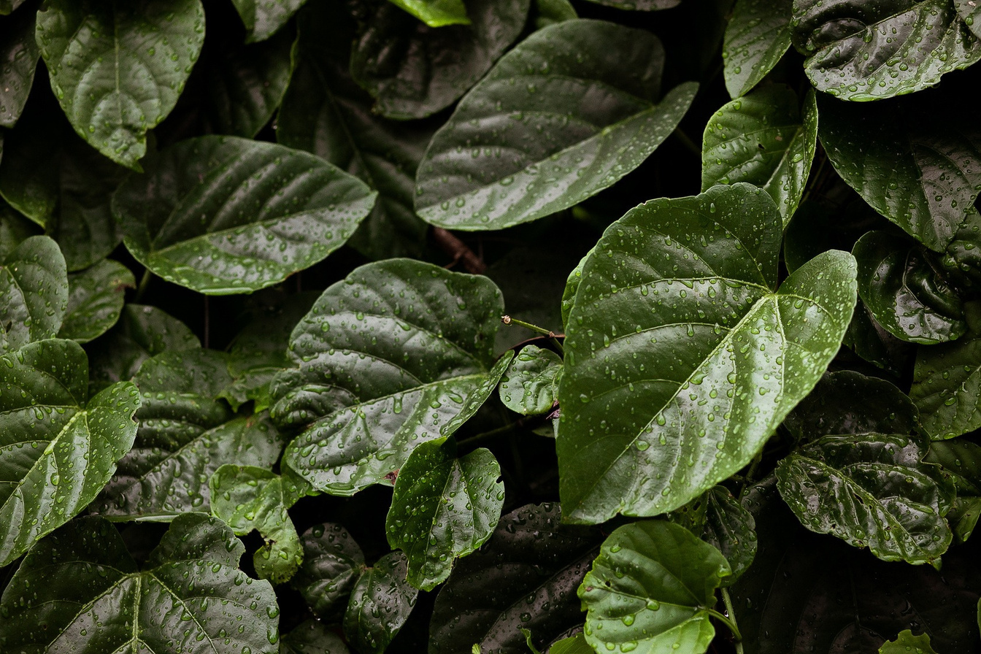
INTRODUCTION
Agriculture is critical to the economy, but plant diseases can devastate crops.
Small-scale farmers often lack access to expert knowledge and timely solutions.
Problem Statement
The challenge of identifying plant diseases, and lack of knowledge on treatment & prevention measures.

Slide 3

OUR PROJECT
An AI-based system that uses image recognition to detect plant diseases.
Farmers can use a WhatsApp chatbot to upload plant images and receive diagnoses and solutions.
Providesn a diagnosis treatment options, preventive measures, and other relevant advice pertaining to the disease.

Slide 4
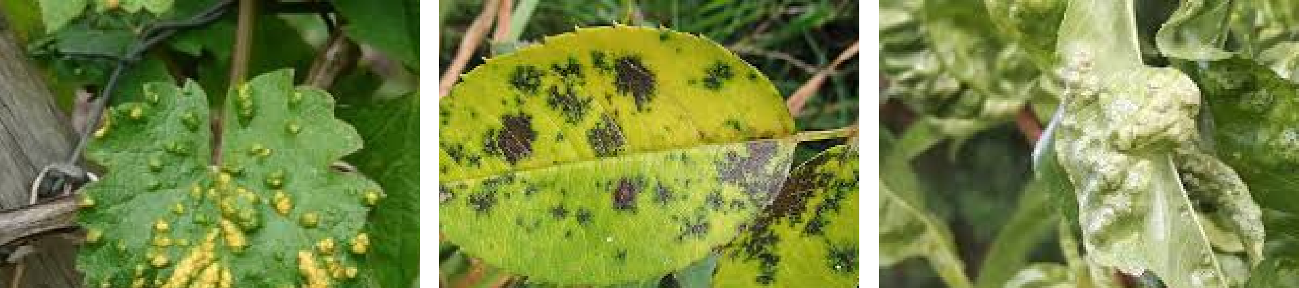
1. Farmers take a picture of the affected plant using their smartphone.
Farmers will then receive:
HOW PLANT PATROL WORKS
Disease diagnosis Symptoms overview Treatment options Preventive measures
2. The image is uploaded via Streamlit
3. The AI model processes the image and identifies potential diseases.

Slide 5

DATA PREPARATION
We gathered a diverse dataset of plant images with corresponding disease labels, ensuring image clarity, resolution, and consistency.
We accurately labeled images with disease categories.
We ensured standard image dimensions for consistent input.

Slide 6

TECHNOLOGY
Image Recognition
Feature Extraction
Using RESNET-9, a deep learning model to analyze plant images.
Identifying key features related to plant diseases.
Classification
Diagnosis
Categorizing images into different disease categories.
Providing farmers with tailored treatment options and preventive measures based on the identified disease.

Slide 7
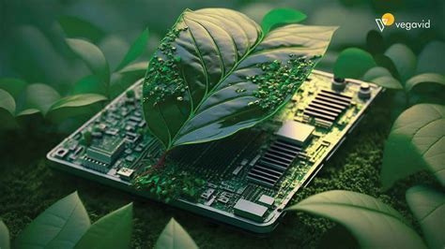
MODEL DEVELOPMENT
We chose a suitable deep learning architecture, CNN, accounting for the size and complexity of the plant disease dataset.
We trained our model to automatically extract the most
relevant features from the plant images, ensuring accurate
disease detection.
We iteratively fed the model with training data, allowing it to
learn and identify patterns and relationships between various
plant diseases.
We evaluated the model's performance on a separate
validation set to monitor accuracy and prevent overfitting
during the training process, and achieved accuracy levels of
over 90%.

Slide 8
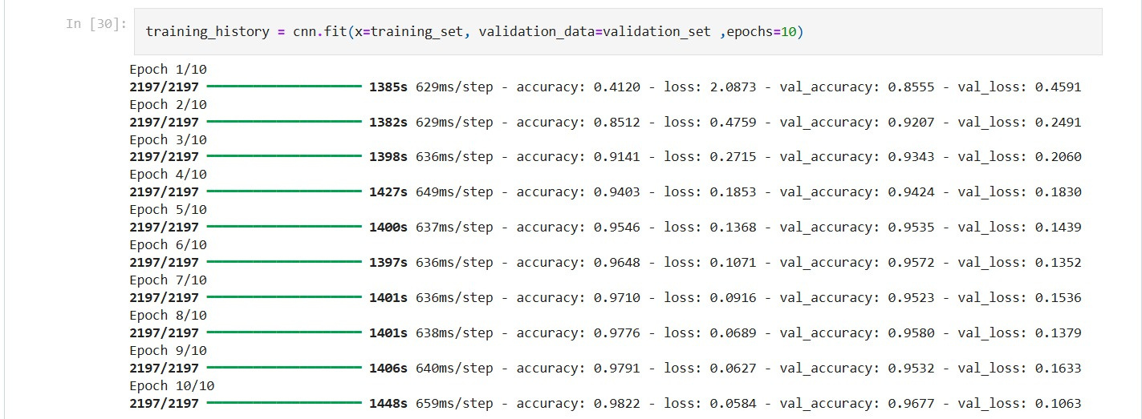
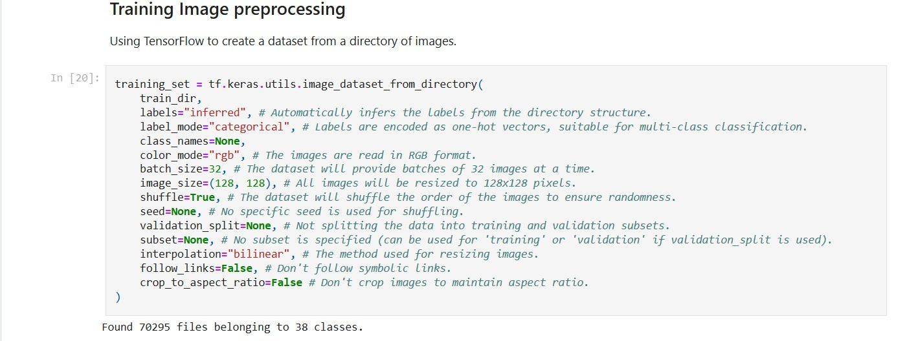
MODEL TRAINING

Slide 9
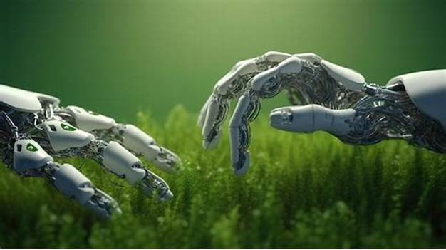
VALIDATION & TESTING
For validation and testing, we used cross-validation to ensure the model’s accuracy across multiple plant diseases, improving its generalizability.
To simulate real farmer interactions, we conducted tests within Streamlit, uploading images from various devices and in diverse conditions to assess the model's robustness.
We will continue to collect user feedback via an in-app form, allowing us to refine both the model and interface based on real-world usage, enhancing accuracy and ensuring a user-friendly experience tailored to farmers' needs.

Slide 10
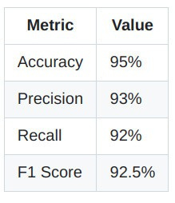
PERFORMANCE METRICS
Accuracy over time: Rapid improvement with validation accuracy jumping from 83% in the first epoch to 99.2% by the end of training.
Training vs. Validation loss: The model maintains low error rates, indicating it generalizes well to new data.
Learning rate monitoring: A dynamic learning rate adjustment (one cycle policy) ensures without
efficient overfitting.
and
stable
training

Slide 11
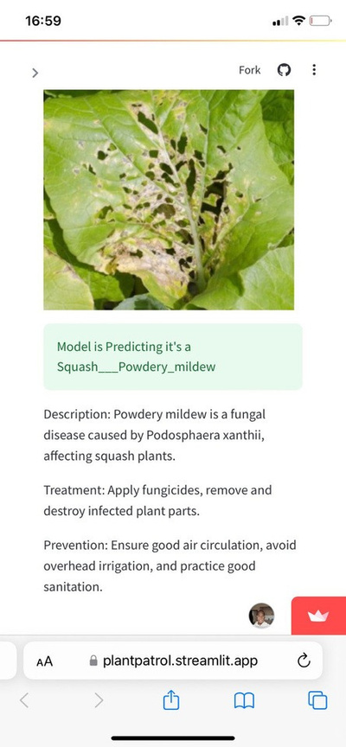
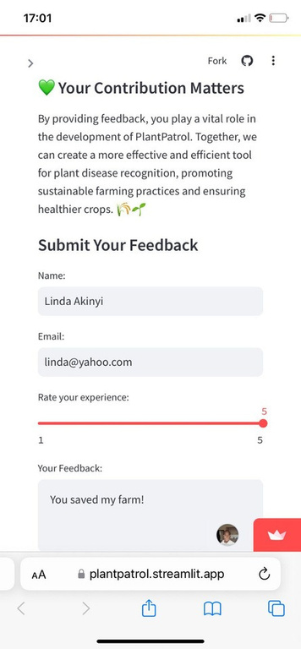
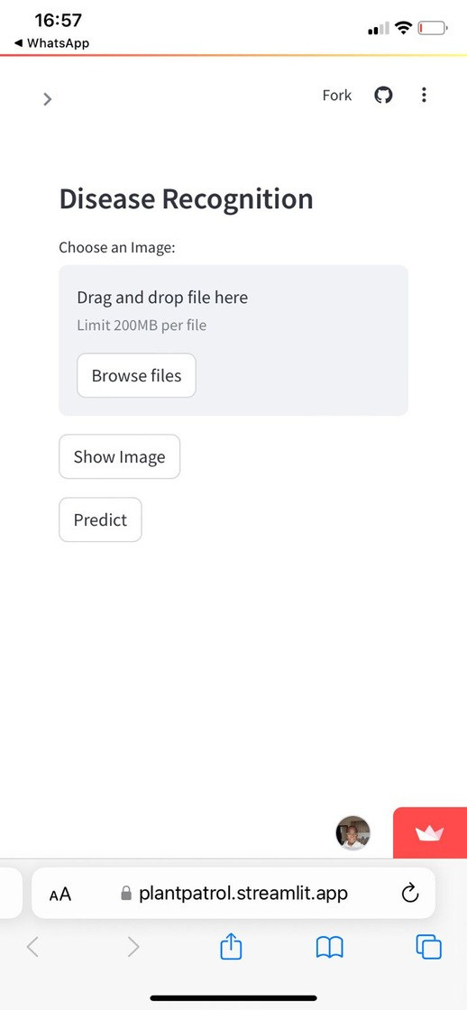
APP INTEGRATION
User Interface with Streamlit
Developed a user-friendly interface in Streamlit, allowing farmers to upload plant images directly from their devices. Designed intuitive buttons and instructions for easy navigation, guiding users through the image upload and diagnosis process.
User support
The system generates a diagnosis along with treatment options and preventive measures. These results are then sent directly to the farmer via Streamlit, providing timely, actionable feedback.
Disease Detection
We integrated the AI model with Streamlit to analyze uploaded images instantly. The uploaded images are then processed through the model to detect disease features and diagnose plant conditions, all within the app.

Slide 12
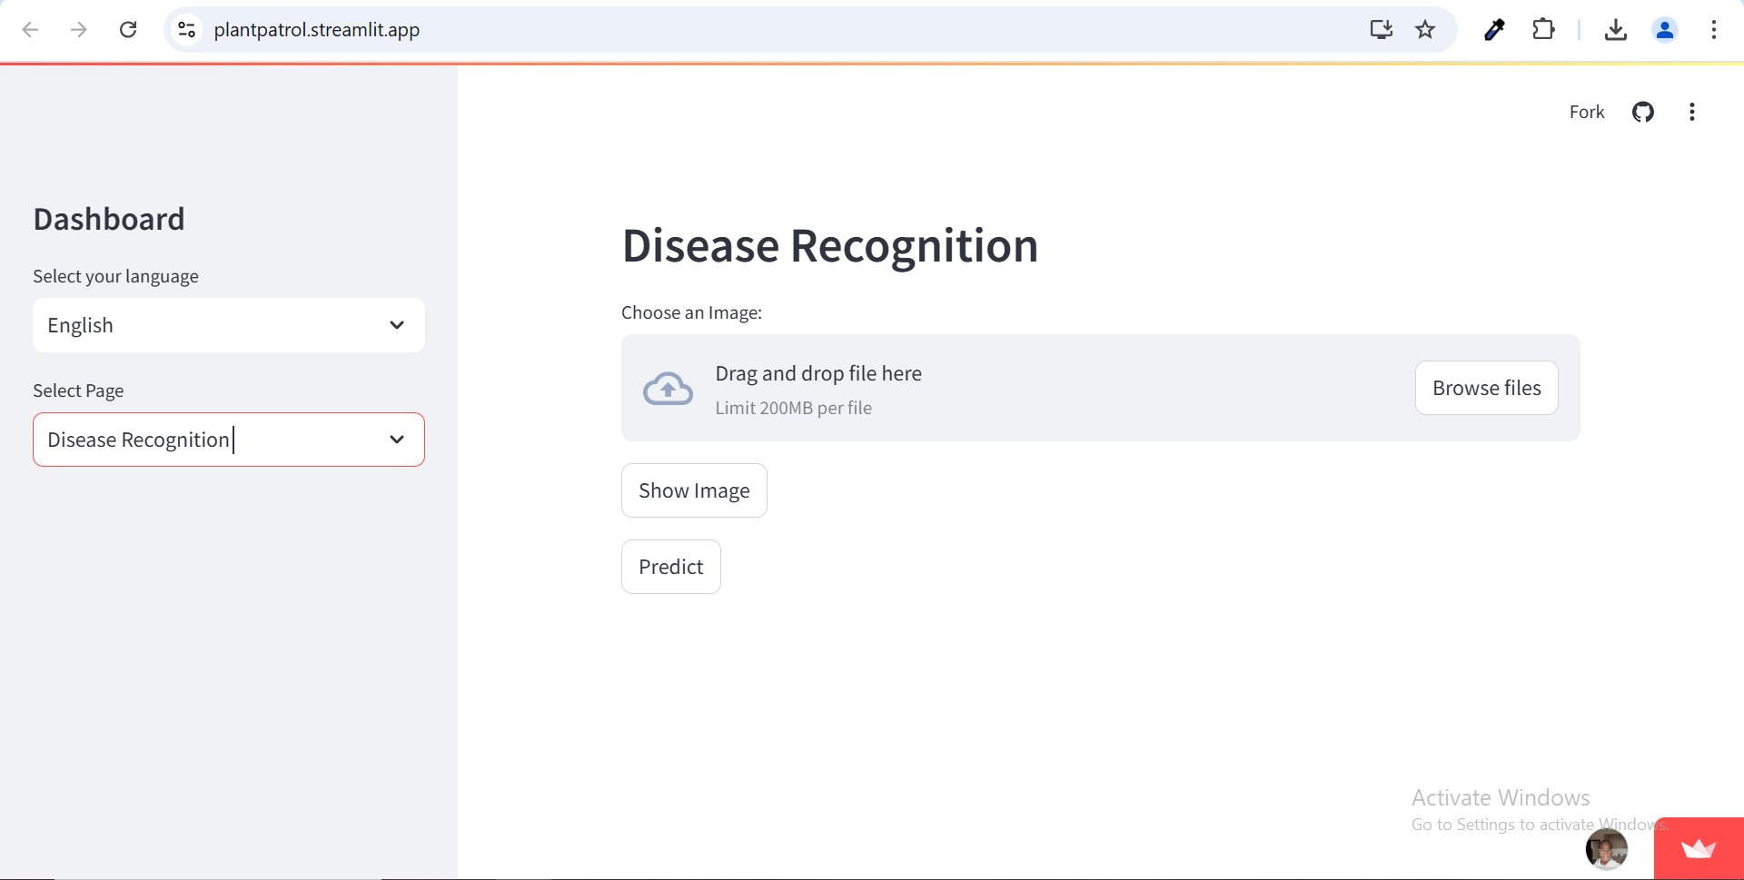

Slide 13
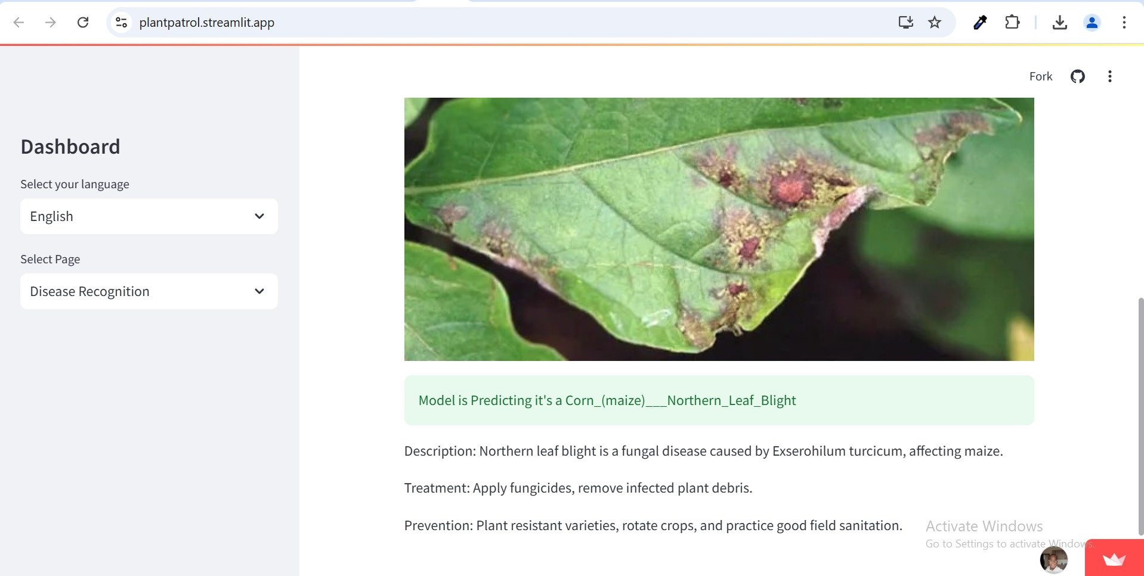

Slide 14
IMPACT ON AGRICULTURE
Increased Productivity. Early detection prevents crop loss, boosting yields and farmer income.
Cost-Effective. Reduces the need for expert inspections, making disease management affordable to all farmers
Improved Access. Can be used by all farmers with access to a mobile phone. Environmental Benefits: Cuts unnecessary pesticide use, promoting eco-friendly practices. Data-Driven Insights: Tracks disease patterns, aiding policymakers and research for climate adaptation.

Slide 15
Insights
AI Integration in Agriculture: AI enhances agricultural practices by providing real-time disease detection, improving crop health and yield.
User Accessibility: A WhatsApp chatbot makes the technology accessible to farmers with varying technical expertise.
Data-Driven Decisions: AI allows farmers to make quick, informed decisions, reducing crop losses and enhancing food security.
Sustainability Focus: Promotes sustainable farming by reducing pesticide reliance through timely disease detection.
Community Empowerment: Provides local farmers with tools and knowledge to combat plant diseases effectively. 🌿🚜
Limitations
Data Quality and Diversity: Performance depends on the training dataset's quality and diversity.
Environmental Variability: The model may falter with unaccounted-for environmental conditions.
Complexity of Diseases: Similar symptoms across diseases can complicate differentiation.
User Dependency: Accurate image capture and submission by users is crucial.
Technical Limitations: Internet connectivity and smartphone access may hinder deployment in rural areas. 📉🌍

Slide 16
Future Work
IoT Integration: Implement real-time plant health monitoring.
Multilingual Support: Add multiple language options.
Expert Collaboration: Partner with agricultural experts for validation and accuracy.
Mobile App: Develop a dedicated mobile application.
Long-term Studies: Assess the system's impact on crop yields and farmer practices over time. 📈🌱
RECOMMENDATIONS
Increase Dataset Diversity. Gather more images across various plant types and disease stages to improve model accuracy.
User Training: Provide tutorials for farmers to improve image quality and ensure accurate diagnosis.
Partnerships with Agricultural Experts: Collaborate with agronomists for validation and to expand disease databases.

Slide 17

Group Name
Plant Patrol
Supervisor
Dr. Stanley Mwangi Chege, PhD
PRESENTED BY
Isaac Ngugi
Serena Rolloh
Naftali Koome
Group Slogan
Your Plants, Our Priority

